Slide 1
11.1 The Byzantine Empire
After Rome split, the Eastern Empire, known as Byzantium, flourishes for a thousand years.

Slide 2
A New Rome in a New Setting
The Eastern Roman Empire
Roman Empire officially divides into East and West in 395.
Eastern Empire flourishes; becomes known as Byzantium
Justinian becomes emperor of Byzantium in 527.
His armies reconquer much of the former Roman territory.
Byzantine emperors head state and church, use brutal politics

Slide 3
Life in the New Rome
New Laws for the Empire
Justinian seeks to revise and update laws for governing the empire
Justinian Code—new set of laws consisting of four main parts
Code regulates much of Byzantine life; lasts for 900 years.

Slide 4
Creating the Imperial Capital
Justinian launches a program to beautify the capital, Constantinople.
Constructs new buildings; builds magnificent church, Hagia Sophia.
Byzantines preserve Greco-Roman culture and learning.

Slide 5
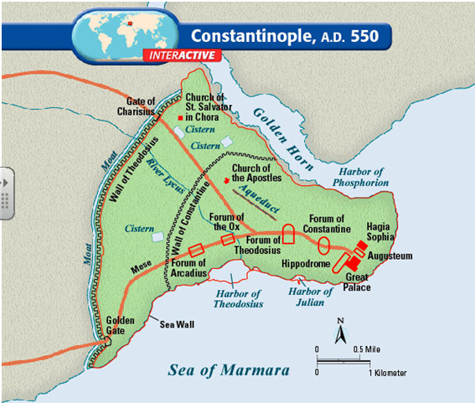

Slide 6
Constantine’s Hectic Pace
City becomes trading hub with major marketplace.
Giant Hippodrome offers chariot races and other entertainment.
Racing fans start riots in 532; the government restores order violently.
Empress Theodora is the powerful wife and adviser to Justinian.

Slide 7
The Empire Falls
Years of Turmoil
Justinian dies in 565; the empire faces many crises after his death.
Attacks from East and West
Byzantium faces attacks from many different groups.
Empire survives through bribery, diplomacy, and military power.
Constantinople falls in 1453; brings an end to the Byzantine Empire.

Slide 8
The Church Divides
A Religious Split
Christianity develops differently in Eastern and Western Roman Empires.
Two churches disagree over many issues, including the use of icons.
Icons are two-dimensional religious images used to aid in prayer.
Leading bishop of Eastern Christianity is known as a Patriarch.
In the West, the pope excommunicates the emperor, banishing him from the church over the iconoclast controversy.

Slide 9
Linguistic Disunity
West—dominant language Latin
East—dominant language Greek
Decline in bilingualism after the fall of the western empire
Linguistic disunity develops into cultural disunity
Different religious rites and liturgy develop
Different approaches to Christian doctrine emerge

Slide 10
Papal Supremacy and the Nicene Creed
Pope Leo IX claimed he held authority over the four eastern patriarchs.
The Pope in 1014 inserted the “Filioque clause” (the words “and the son” in regards to the procession of the Holy Spirit) into the Latin version of the Nicene Creed. (This was not allowed by the Roman church in the Greek version). Leo IX asserted the papacy’s right to do so. The Eastern Orthodox believed this to be a violation of the 7th canon of the Council of Ephesus, and viewed this clause as a western innovation and heresy.
The Eastern Orthodox today state that the 28th Canon of the Council of Chalcedon established the equality of the Bishops of Rome and Constantinople, therefore, the Roman pontiff could not claim authority over Constantinople.

Slide 11
Iconoclast Controversy
The Byzantine Emperor Leo III outlawed the veneration of icons in the 8th century. Some believe this to be a result of the pressures of Islam. Those who were against the use of icons in the church were called “iconoclasts.” The first period of iconoclasm occurred from 730-787 C.E. A second period of iconoclasm occurred from 814-842 C.E.
Arguments usually surrounded the understanding of how to depict the two natures of Jesus Christ in Christian theological teaching. “Iconodules” (supporters of the use of icons) believed that to disallow depicting Jesus artistically denied the incarnation.
The western church rejected iconoclasm. However, icons, which are generally two dimensional works of art were generally not used. Instead, statues were allowed in the western church .

Slide 12
Different Church/State Relations
Caesaropapism in the east subordinated the church to the religious claims of the dominant political state. In the Byzantine Empire, the emperor had supreme authority over the church.
In the west the church was relatively independent of the state due to the fall of the western empire and a lack of imperial authority. Later, when strong kingdoms emerge in Western Europe, the investiture controversy surfaces creating church/state conflicts.

Slide 13
Pope and patriarch excommunicate each other over religious doctrines and disputes over jurisdiction.
Eastern and Western churches officially split in 1054.
West—Roman Catholic Church
East—Orthodox Church

Slide 14
Byzantine Missionaries Convert the Slavs
Eastern Orthodox missionaries seek to convert the northern peoples known as the Slavs.
Missionaries create the Cyrillic alphabet—the basis for many Slavic languages.
Alphabet enables many groups to read the Bible.

